Slide 1
Blendenpik: Supercharging LAPACK'S Least-Squares Solver
Brandon, Jacob, Adam

Slide 2
The Paper
Blendenpik: Supercharging LAPACK'S Least-Squares Solver
Authors:
Haim Avron, Petar Maymounkov, Sivan Toledo
SIAM Journal on Scientific Computing, Vol. 32, No. 3, 2010

Slide 3
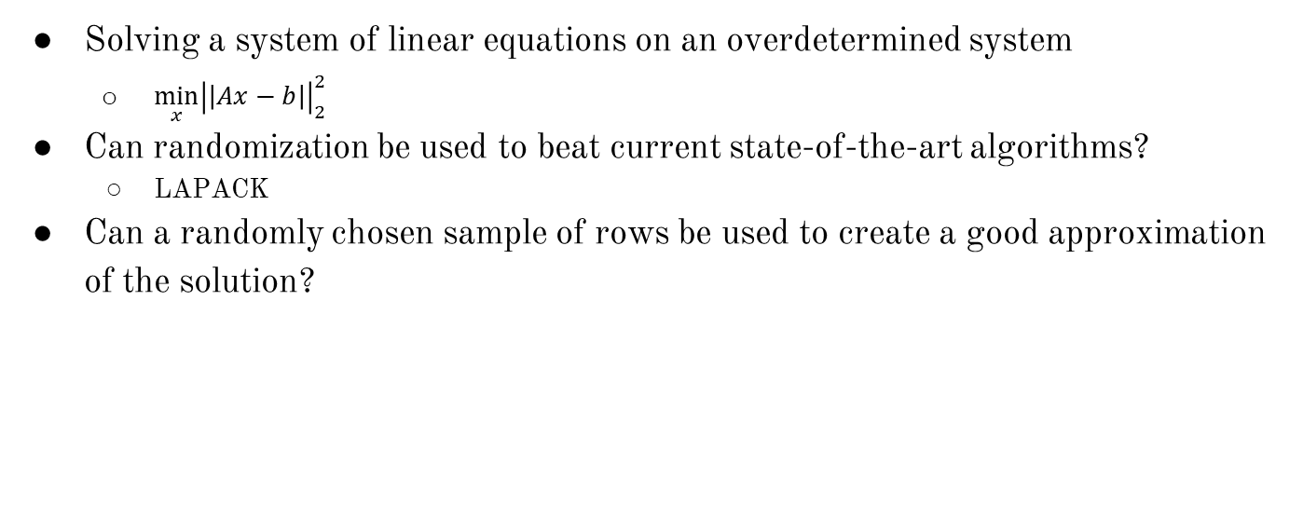
The Problem
Solving a system of linear equations on an overdetermined system
$\min_{x}{\left|\left|Ax−b\right|\right|}_{2}^{2}$
Can randomization be used to beat current state-of-the-art algorithms?
LAPACK
Can a randomly chosen sample of rows be used to create a good approximation of the solution?

Slide 4
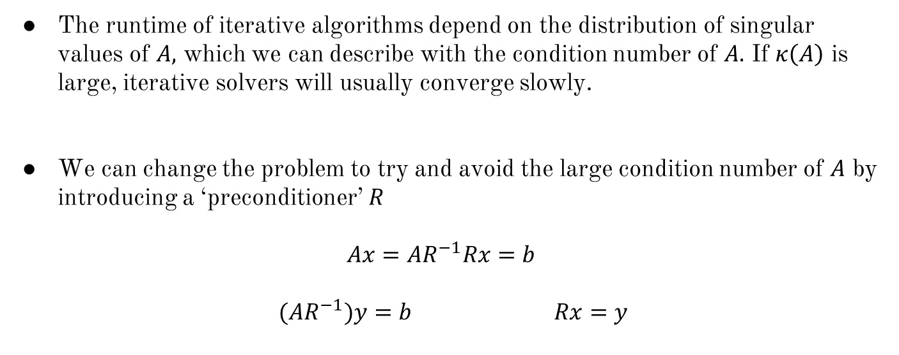
Ideas for a Least Squares Solver
The runtime of iterative algorithms depend on the distribution of singular values of $A,$ which we can describe with the condition number of $A.$ If $κ\left(A\right)$ is large, iterative solvers will usually converge slowly.
We can change the problem to try and avoid the large condition number of $A$ by introducing a ‘preconditioner’ $R$
$$Ax=AR^{−1}Rx=b$$
$(AR^{−1})y=b$ $Rx=y$

Slide 5
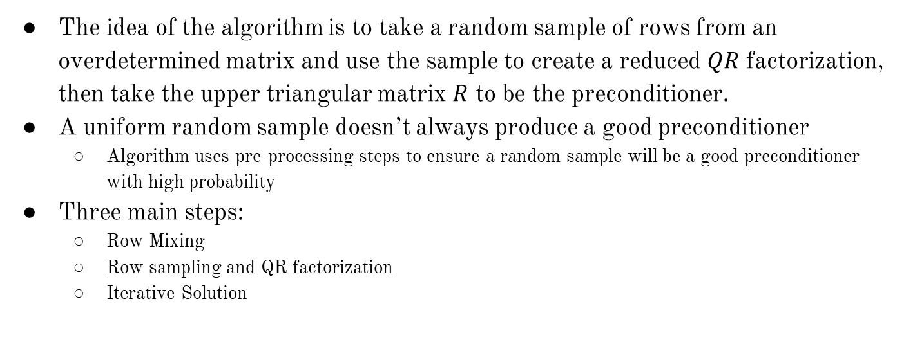
The Algorithm
The idea of the algorithm is to take a random sample of rows from an overdetermined matrix and use the sample to create a reduced $QR$ factorization, then take the upper triangular matrix $R$ to be the preconditioner.
A uniform random sample doesn’t always produce a good preconditioner
Algorithm uses pre-processing steps to ensure a random sample will be a good preconditioner with high probability
Three main steps:
Row Mixing
Row sampling and QR factorization
Iterative Solution

Slide 6
The Result
Blendenpik beats LAPACK on any tall, dense matrix
Blendenpik is slower on tiny matrices, nearly square matrices, and some sparse matrices
Blendenpik is numerically-backwards stable
Achieves residuals similar to direct QR factorization-based solvers
Scales significantly better than any other QR-based solver

Slide 7
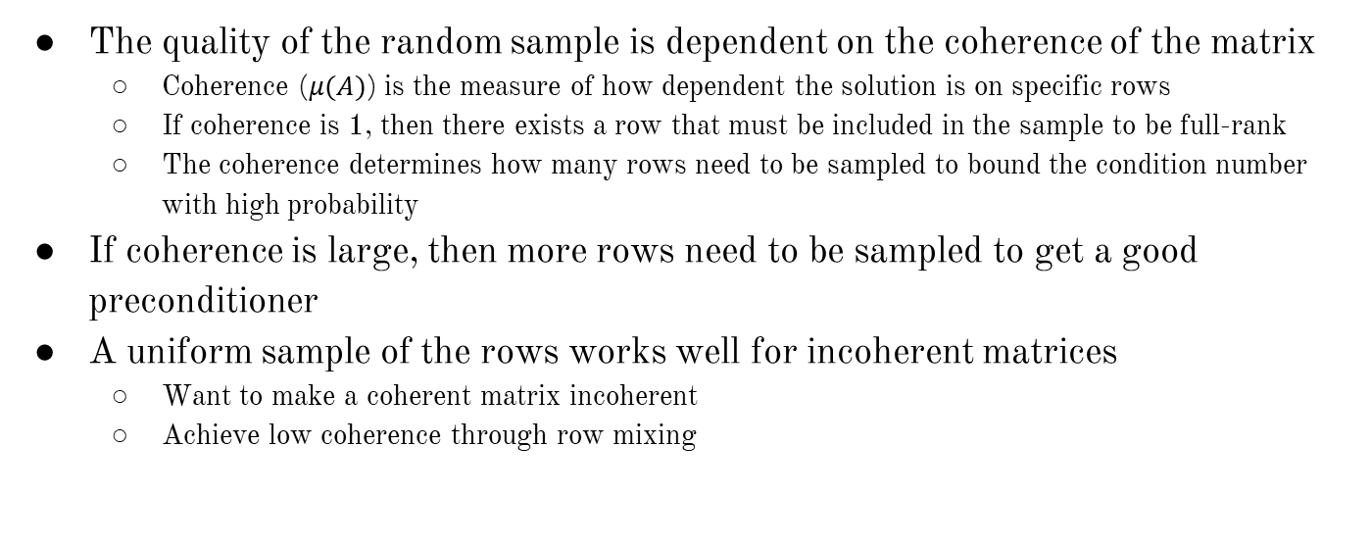
The Theory
The quality of the random sample is dependent on the coherence of the matrix
Coherence ($μ(A)$) is the measure of how dependent the solution is on specific rows
If coherence is 1, then there exists a row that must be included in the sample to be full-rank
The coherence determines how many rows need to be sampled to bound the condition number with high probability
If coherence is large, then more rows need to be sampled to get a good preconditioner
A uniform sample of the rows works well for incoherent matrices
Want to make a coherent matrix incoherent
Achieve low coherence through row mixing

Slide 8
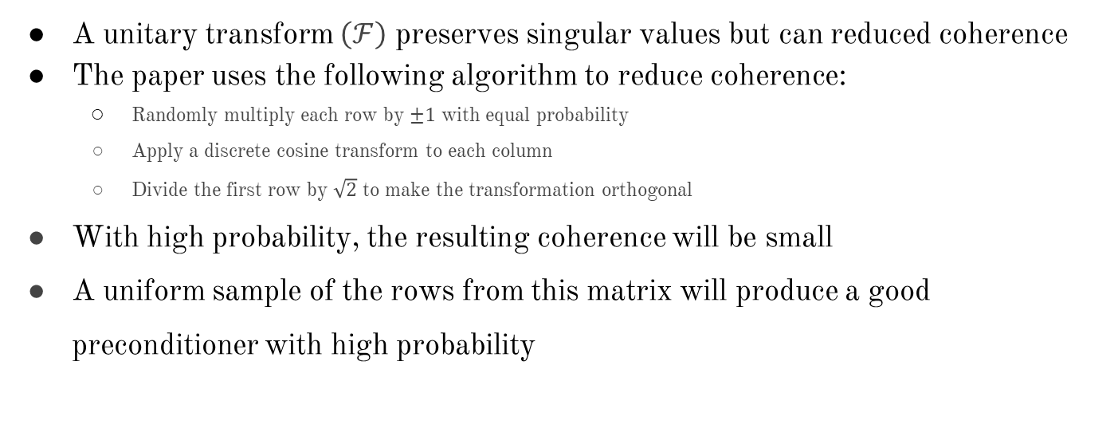
Row Mixing
A unitary transform $\left(ℱ\right)$ preserves singular values but can reduced coherence
The paper uses the following algorithm to reduce coherence:
Randomly multiply each row by $±1$ with equal probability
Apply a discrete cosine transform to each column
Divide the first row by $\sqrt{2}$ to make the transformation orthogonal
With high probability, the resulting coherence will be small
A uniform sample of the rows from this matrix will produce a good preconditioner with high probability

Slide 9
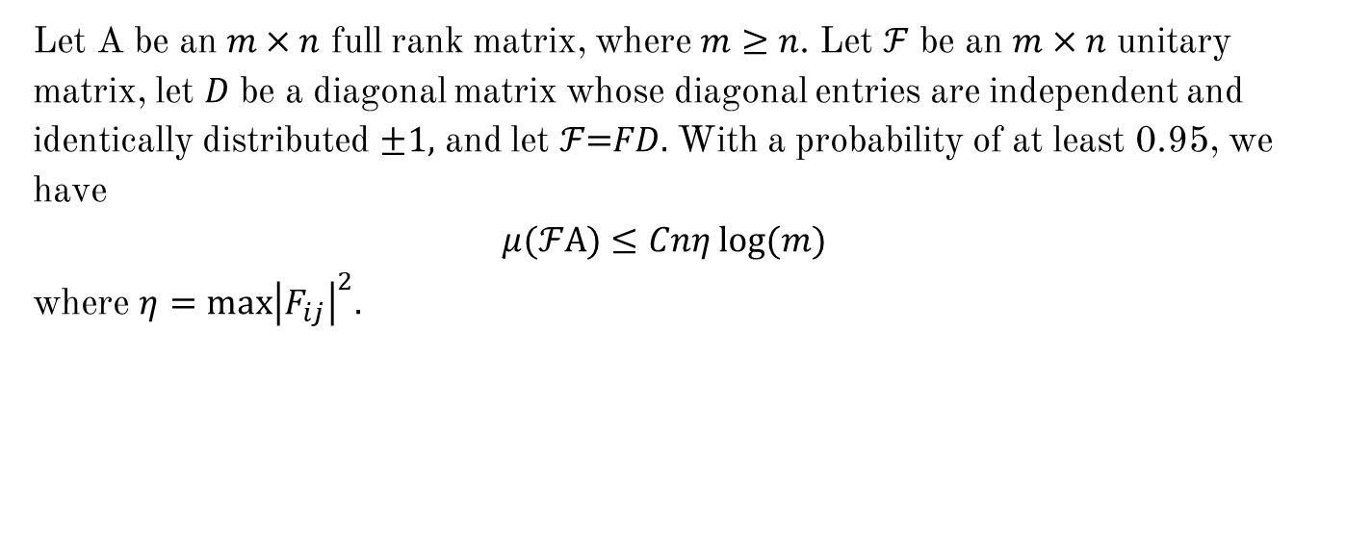
Row Mixing
Let A be an $m×n$ full rank matrix, where $m≥n$. Let $\text{ℱ}$ be an $m×n$ unitary matrix, let $D$ be a diagonal matrix whose diagonal entries are independent and identically distributed $±1,$ and let $\text{ℱ}\text{=}FD.$ With a probability of at least 0.95, we have
$$μ(\text{ℱ}\text{A}\text{)}≤Cnη log(m)$$
where $η=max{\left|F_{ij}\right|}^{2}.$

Slide 10
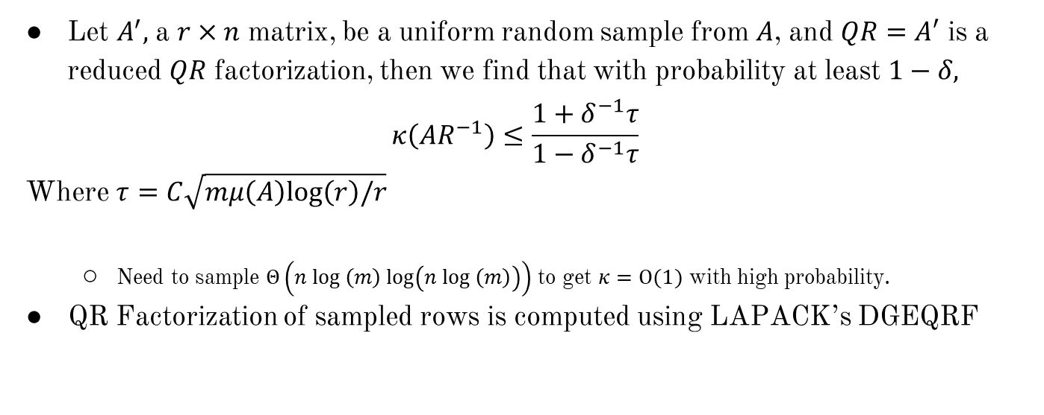
Row Sampling and QR Factorization
Let $A^{′},$ a $r×n$ matrix, be a uniform random sample from $A$, and $QR=A′$ is a reduced $QR$ factorization, then we find that with probability at least $1−δ,$
$$κ\left(AR^{−1}\right)≤\frac{1+δ^{−1}τ}{1−δ^{−1}τ}$$
Where $τ=C\sqrt{mμ\left(A\right)log\left(r\right)/r}$
Need to sample $Θ\left(n log \left(m\right) log\left(n log \left(m\right)\right)\right)$ to get $κ=O(1)$ with high probability.
QR Factorization of sampled rows is computed using LAPACK’s DGEQRF

Slide 11
Iterative Solution
LSQR is used on the sampled rows to approximate the solution
This algorithm is about as stable as a QR-based solver
Most of the running time is spent on multiplying vectors by A and A^{T}

Slide 12
The Cost
Row Mixing
Θ(mn log m)
Row Sampling and QR Factorization
Θ(n³)
Iterative Solution
Most costly phase of algorithm
Each iteration is Θ(mn)
Number of iterations grows slowly

Slide 13
Comparison to Prior Algorithms
LAPACK
Blendenpik outperforms LAPACK on most matrices
Faster least squares approximation
Proposes a more sophisticated algorithm that leads to a small residual for any matrix
Small uniform sample does not work on any matrix
A fast randomized algorithm for overdetermined linear least-squares regression
Uses a uniform random sample of the rows
May not work in matrices with high coherence

Slide 14
Different Unitary Transformations
Transformation used in the algorithm is the discrete cosine transform (DCT)
Other transformations are available:
Walsh-Hadamard transform (WHT)
Discrete Hartley transform (DHT)
WHT is the best in theory, but sometimes fails to mix rows well enough
DHT and DCT work better in practice and are easier to apply to arbitrary matrices

Slide 15
Row Mixing Evaluation
Larger sample size
Greater probability of getting a good preconditioner
Makes other parts of the algorithm take more time
Computation time was found to decrease, then increase as sample size increased

Slide 16
Ill-Conditioned Matrices
This algorithm beats the unpreconditioned LSQR for ill-conditioned matrices
The unpreconditioned LSQR beats Blendenpik for well conditioned matrices

Slide 17
Coherence Evaluation
Algorithm runs longer on matrices with high coherence compared to matrices with low coherence
Blendenpik beast LAPACK in both cases

